Slide 1
brain stroke prediction using DL

Slide 2
Abstract
Brain stroke, also known as a cerebrovascular accident (CVA), is a severe medical condition that can lead to long-term disabilities and even death. Early prediction of stroke risk can help healthcare professionals identify individuals who are at a higher risk and provide timely interventions to prevent stroke occurrences. Many predictive strategies have been widely used in clinical decision-making, such as forecasting disease occurrence, disease outcome, and supporting doctors in prescribing disease treatment. Using a deep learning model on a brain disease dataset, this method of predicting analytical techniques for stroke was carried out. In this model, the goal is to create a deep learning application that identifies brain strokes using a convolution neural network. In addition, three models for predicting the outcomes have been developed. This suggested study uses a CT scan (computed tomography) image dataset to predict and classify strokes
27-Apr-23
Dept of MCA
2
Notes:
2

Slide 3
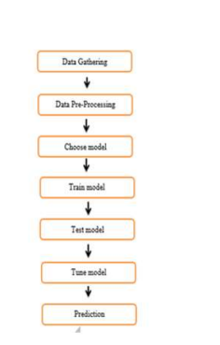
Block Diagram
01/23/2024
Dept of MCA
3
27-Apr-23
Dept of MCA
2
Notes:
3

Slide 4
Existing System
The existing system for brain stroke prediction utilizing data mining techniques involves the analysis of large datasets to identify patterns and relationships between risk factors and stroke occurrences. Data mining algorithms are employed to extract valuable insights from the data, allowing healthcare professionals to make informed decisions regarding stroke prevention and treatment. In this study, we review the current state of the existing system and discuss the data mining techniques commonly used for brain stroke prediction. The existing system incorporates a comprehensive dataset consisting of various patient attributes, including demographic information, medical history, lifestyle factors, and diagnostic test results. Data mining techniques are applied to this dataset to identify key risk factors associated with stroke and to develop predictive models that can accurately forecast the likelihood of stroke occurrences
27-Apr-23
Dept of MCA
<number>
Notes:
4

Slide 5
DISADVANTAGES:
Accuracy is Low.
Only using Data Mining algorithms and ML algorithms in existing methods .
27-Apr-23
Dept of MCA
4
Notes:
5

Slide 6
Proposed System
Using CNN and deep learning models, this study seeks to diagnose brain stroke images. The suggested method uses a Convolutional neural network to classify brain stroke images into normal and abnormal. The best algorithm for all classification processes is the convolutional neural network. We discovered that deep learning models are not only useful for non-medical images but also provide accurate results in medical image diagnostics, particularly in the detection of brain stroke.
Dept of MCA
5
Notes:
6

Slide 7
ADVANTAGES:
Accuracy is Very high.
Better Prediction .
27-Apr-23
Dept of MCA
6
Notes:
7

Slide 8
Methodology
Dataset Upload & Analysis: using this module we will upload dataset and then perform analysis methods such as detecting brain stroke
Dataset Processing & Analytical Methods: using this module we will encode attack labels with integer ID and then split dataset into train and test where application used 80% dataset to train classification
27-Apr-23
Dept of MCA
7
Notes:
8

Slide 9
Methodology
3) Run DL Model: using this module we will trained classification algorithm with above 80% dataset and then build a prediction model
4) Predict Output: using this module we will upload test image and then classification model will predict output based on input image
27-Apr-23
Dept of MCA
8
Notes:
9

Slide 10
SOFTWARE REQUIREMENTS:
Operating system : Windows Family
Coding Language : Python

Slide 11
Hardware Components
Operating system: windows, linux
Processor : minimum intel i3
Ram: minimum 4 gb
Harddisk : minimum 250gb
27-Apr-23
Dept of MCA
11
Notes:
11

Slide 12
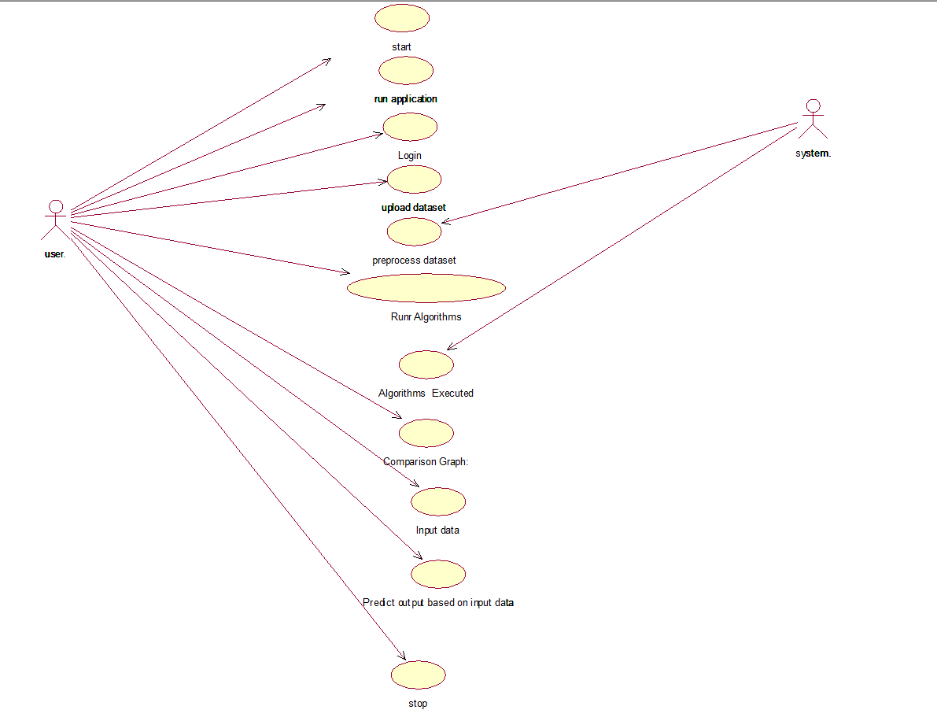
UML
27-Apr-23
Dept of MCA
12
Notes:
12

Slide 13
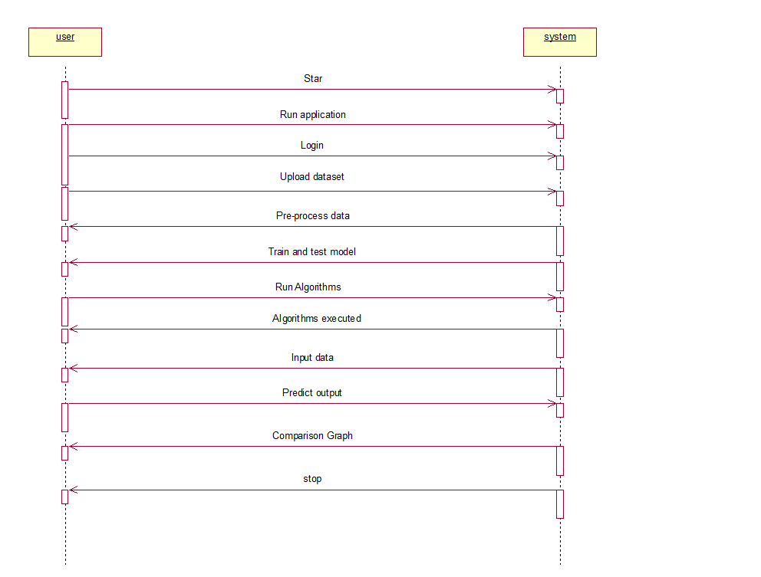
UML
27-Apr-23
Dept of MCA
13
Notes:
13

Slide 14
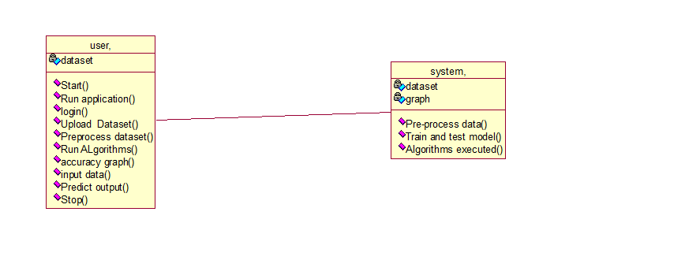
UML
27-Apr-23
Dept of MCA
14
Notes:
14

Slide 15
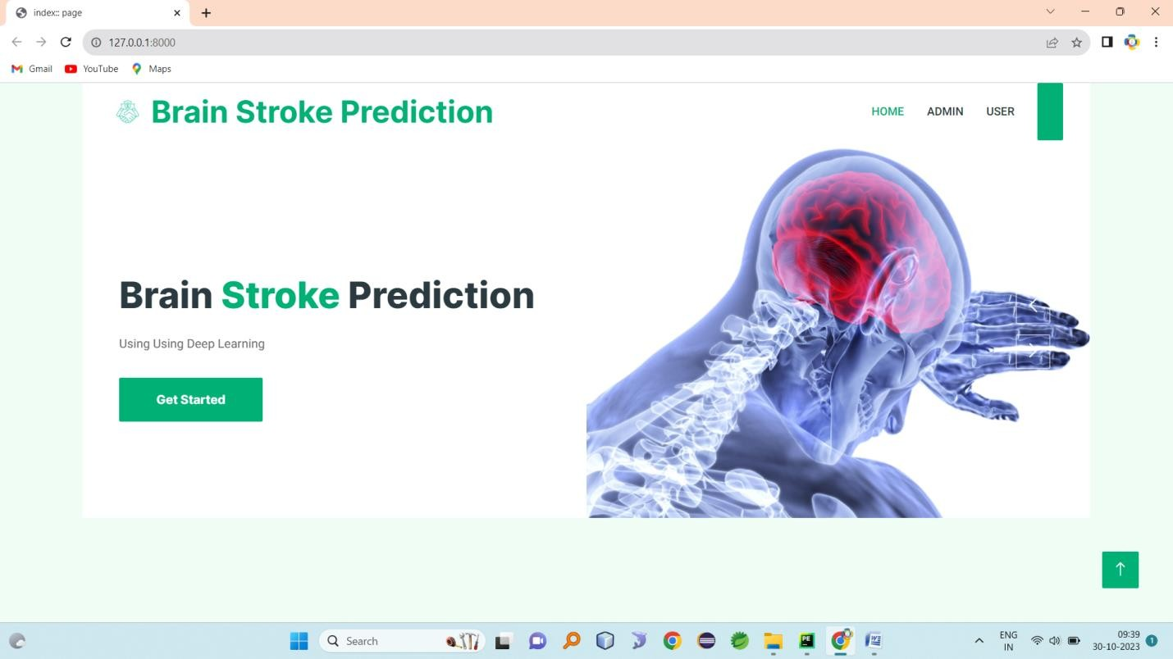
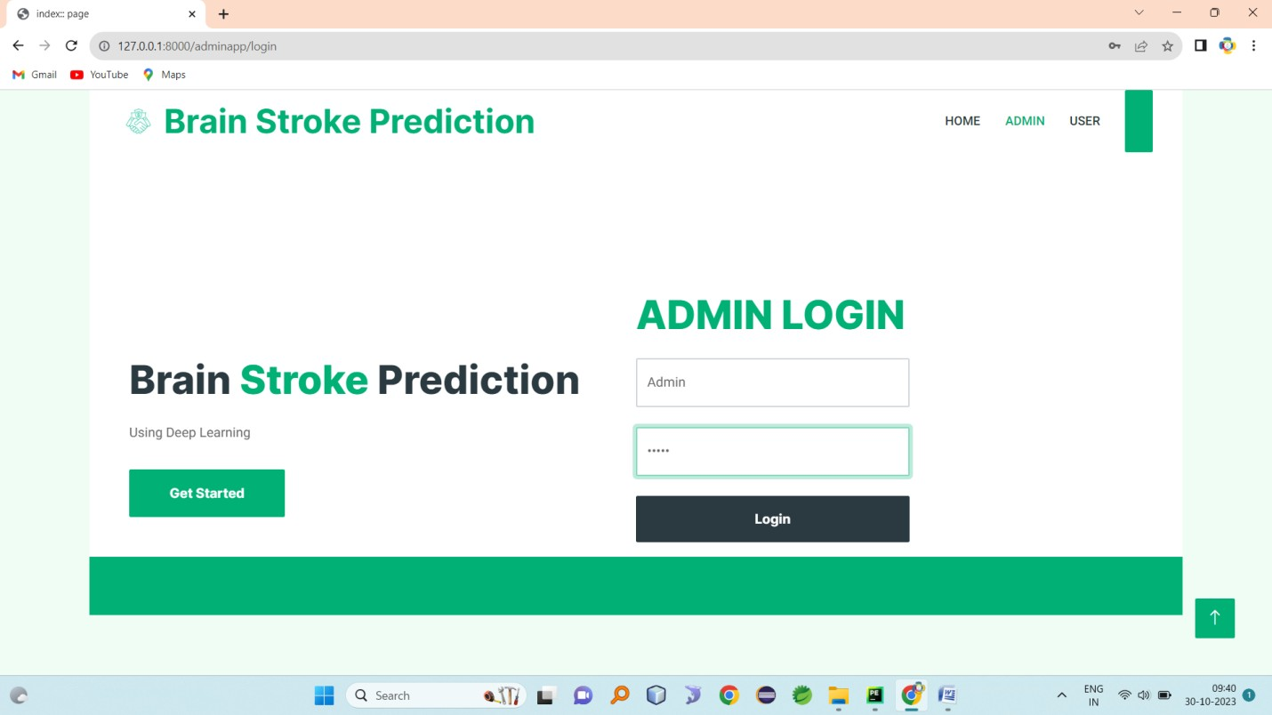
Expected Outcomes
INDEX
Admin login
Admin home

Slide 16
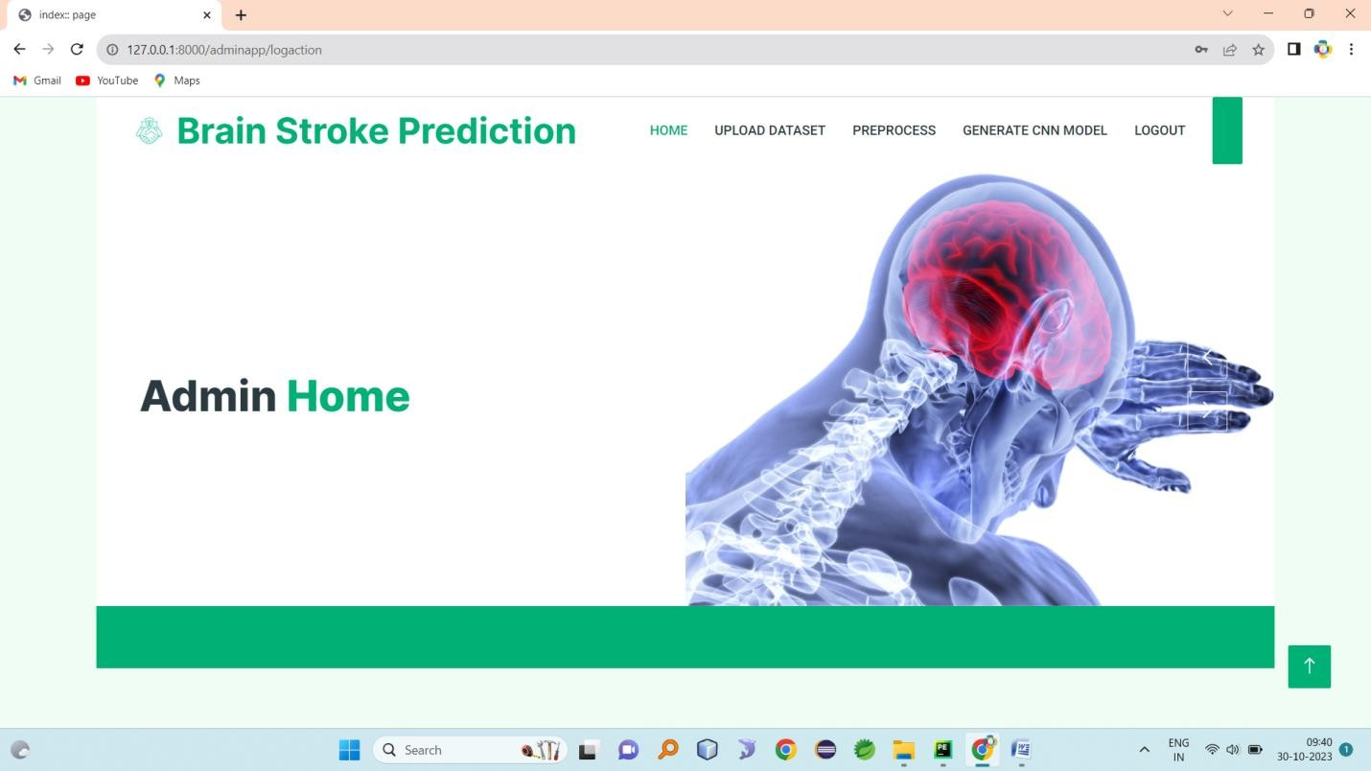
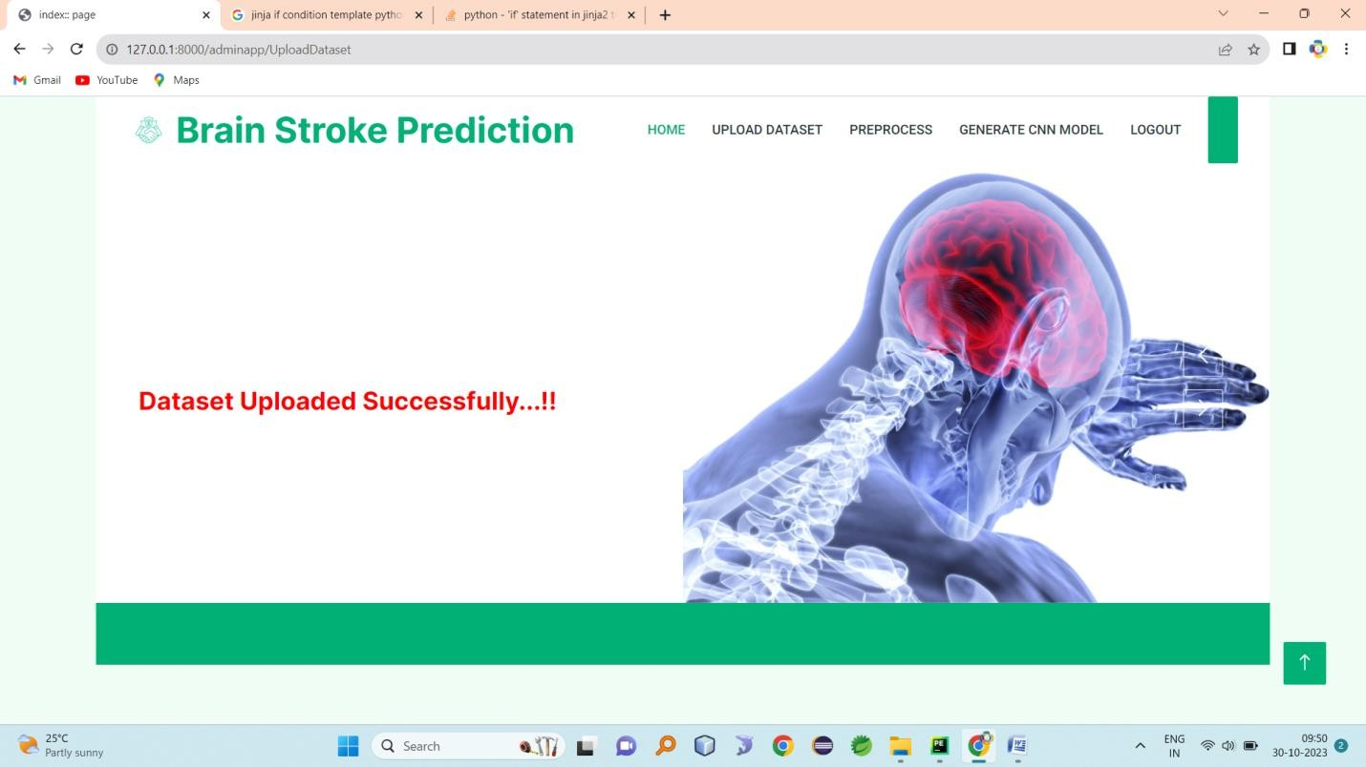

Slide 17
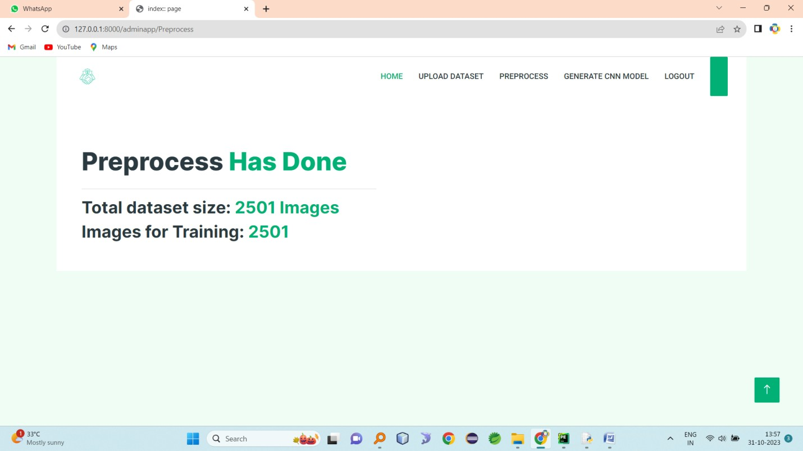
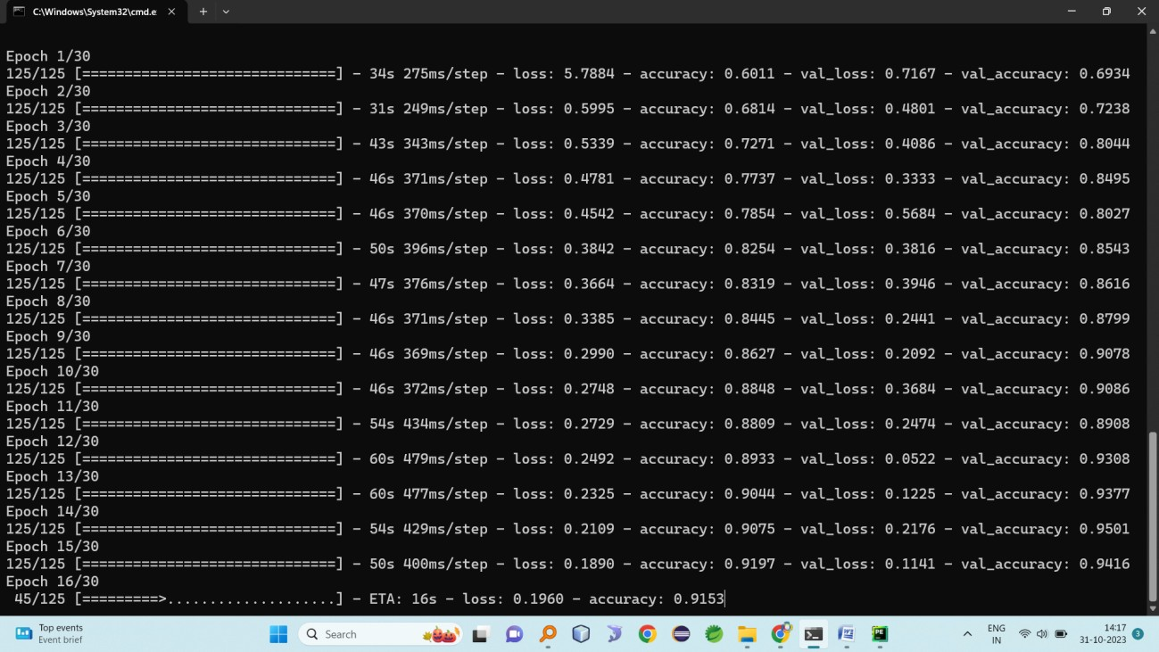

Slide 18
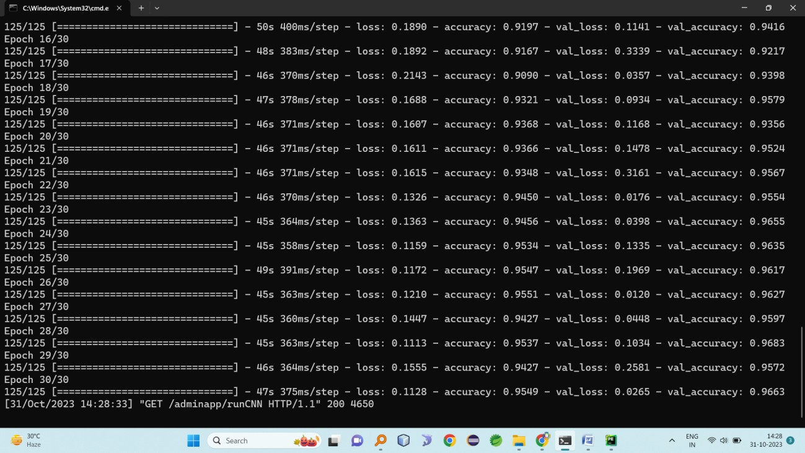
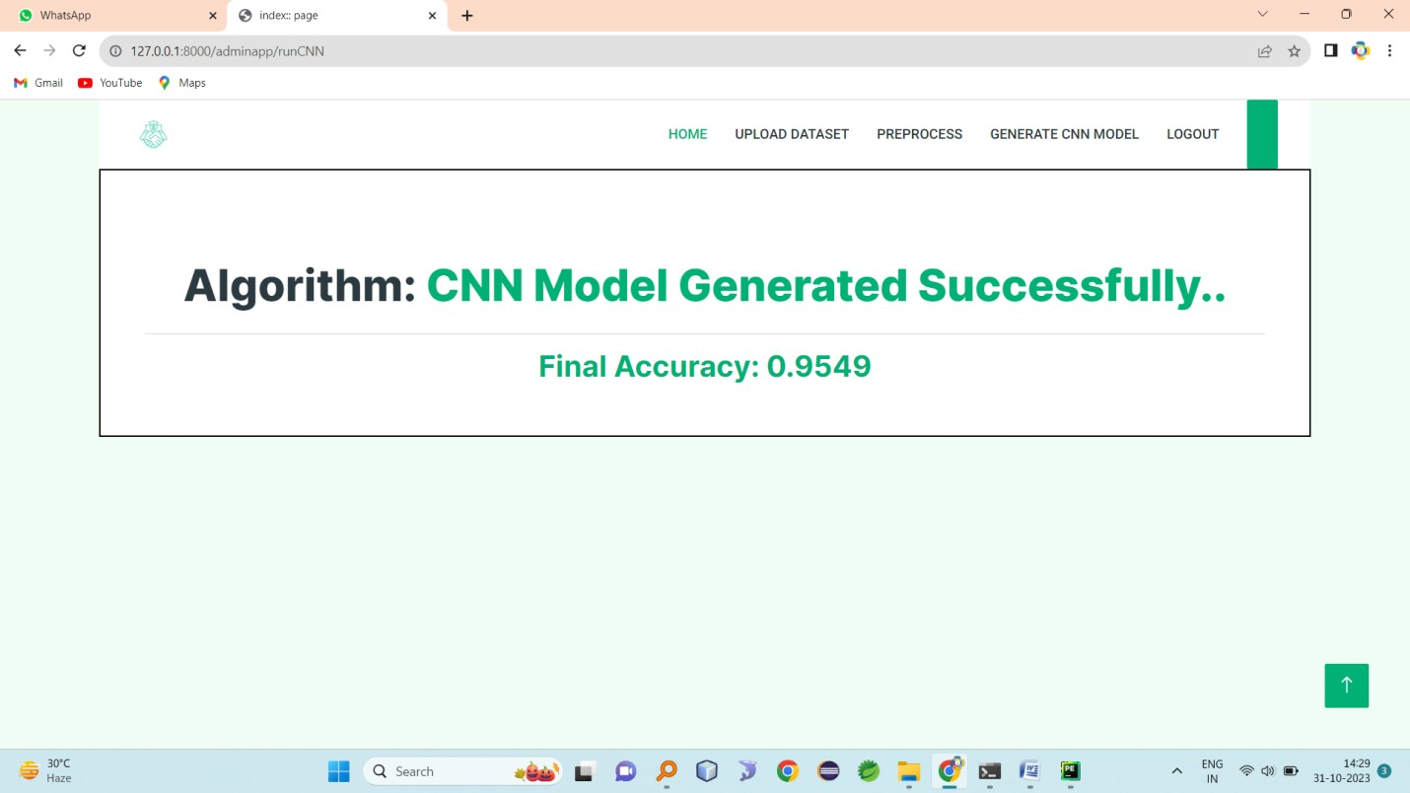
User registration

Slide 19
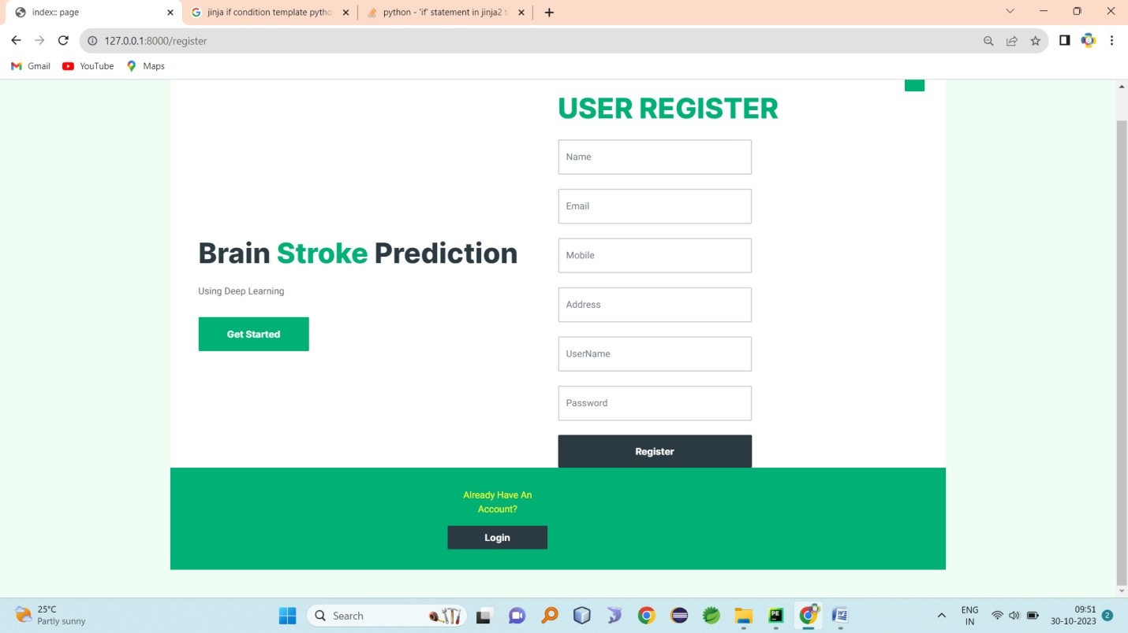
User login

Slide 20
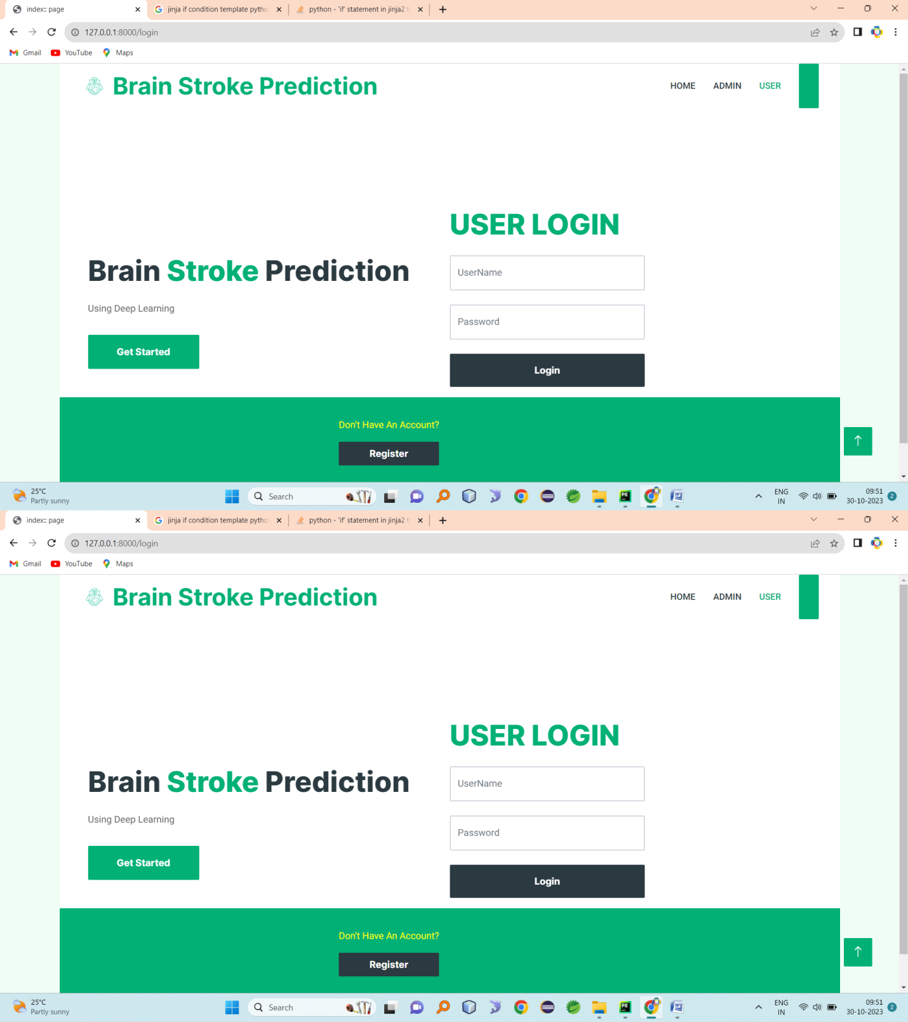
USER PROFILE

Slide 21
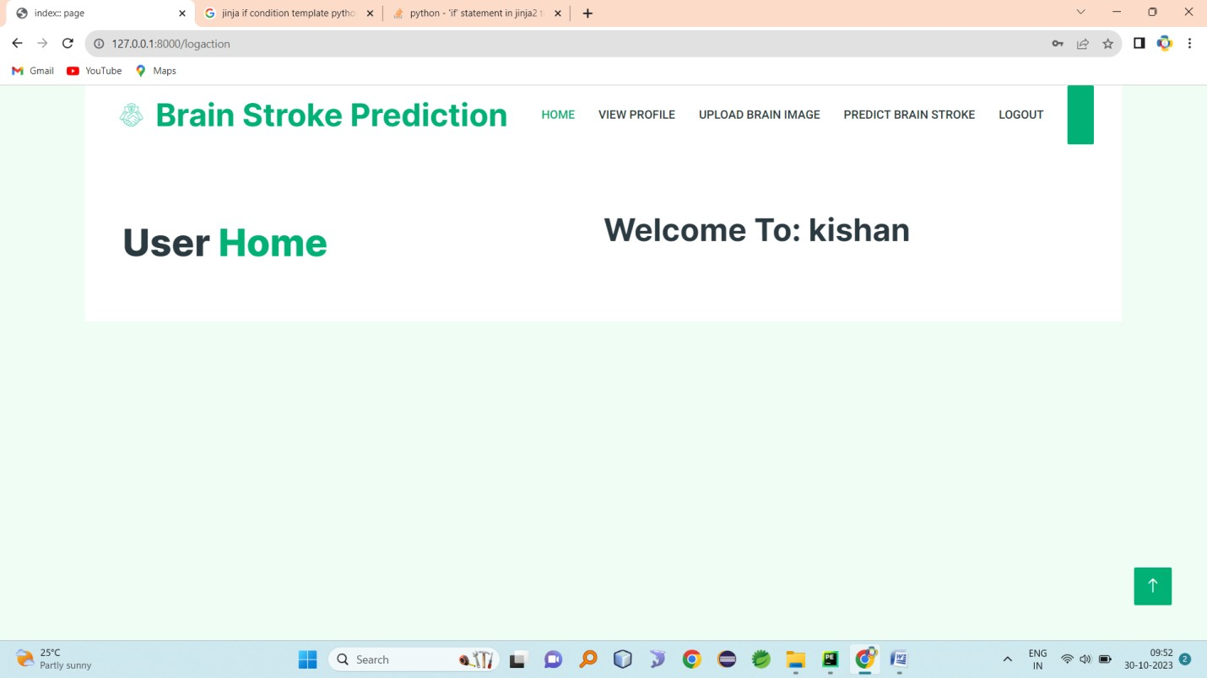
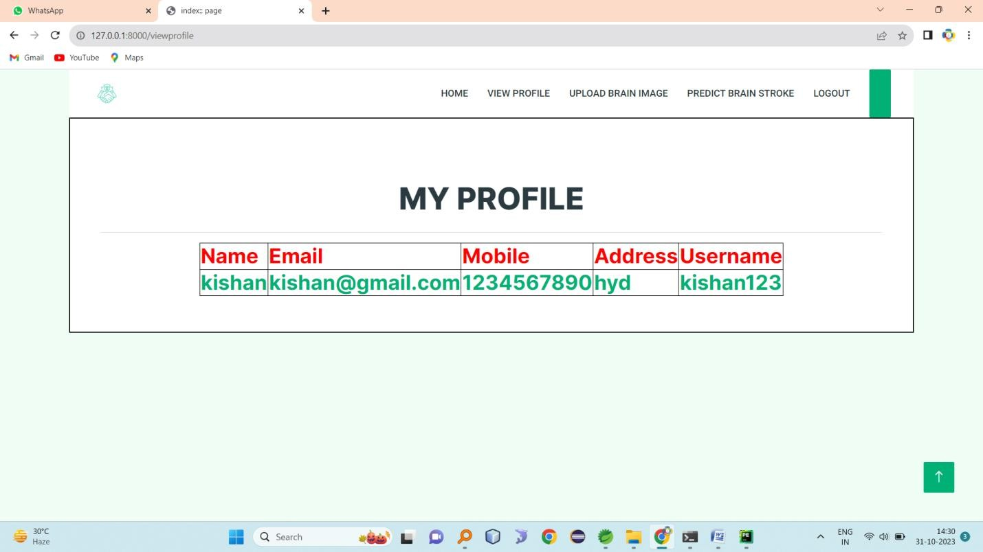
VIEW PROFILE
UPLOAD PIC

Slide 22
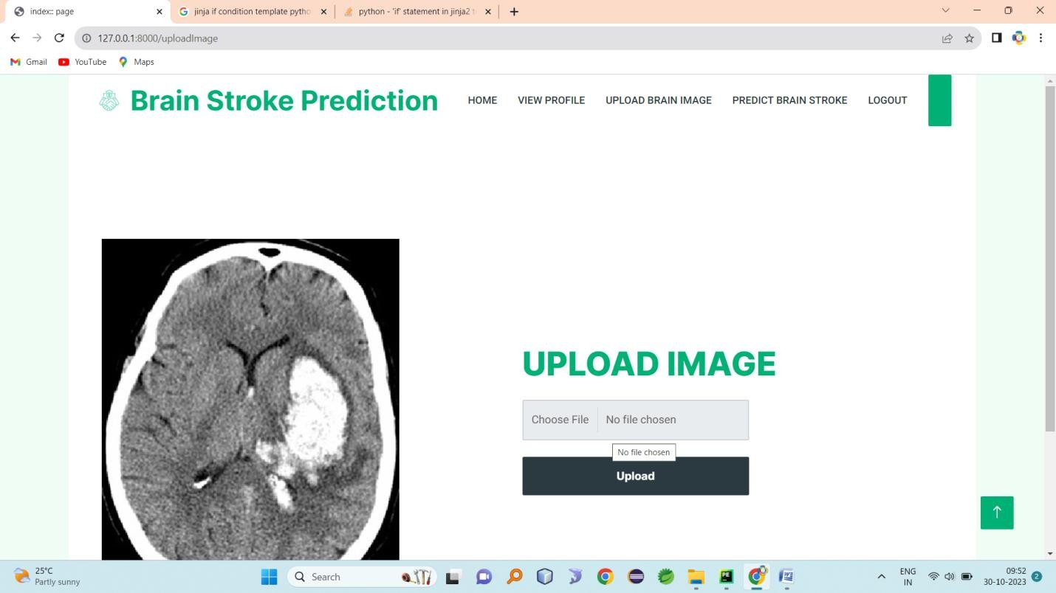
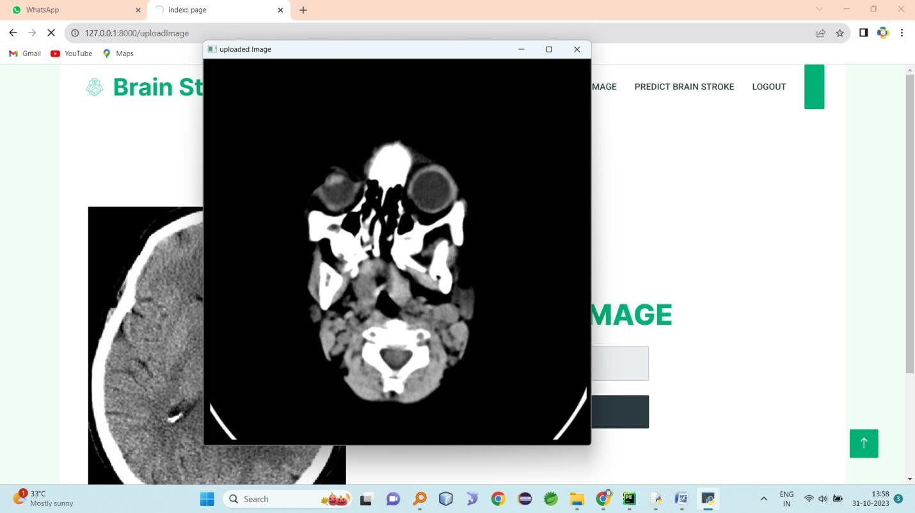
UPLOADED IMAGE
PREDICTED IMAGE

Slide 23
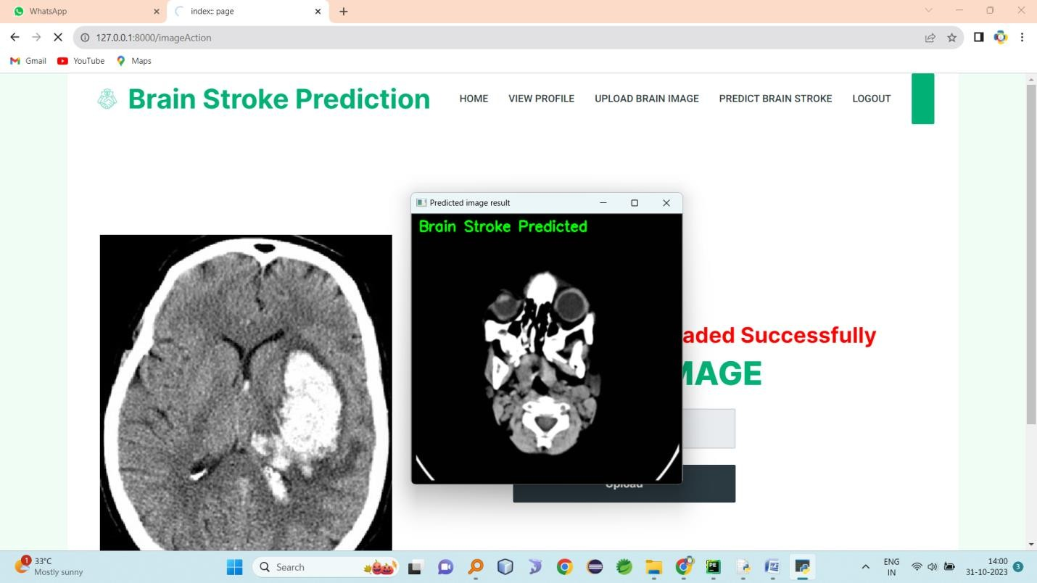
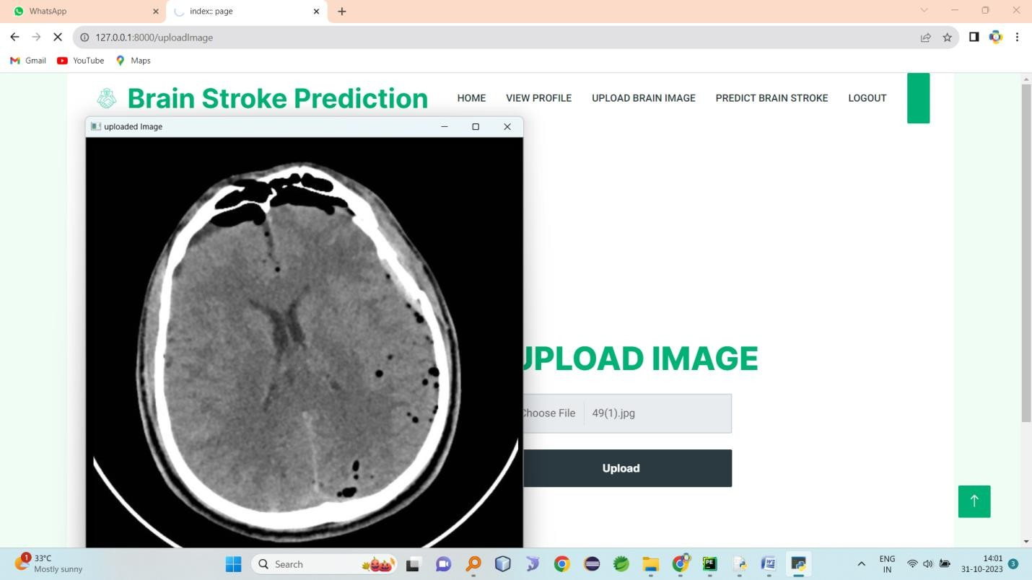
Upload image

Slide 24
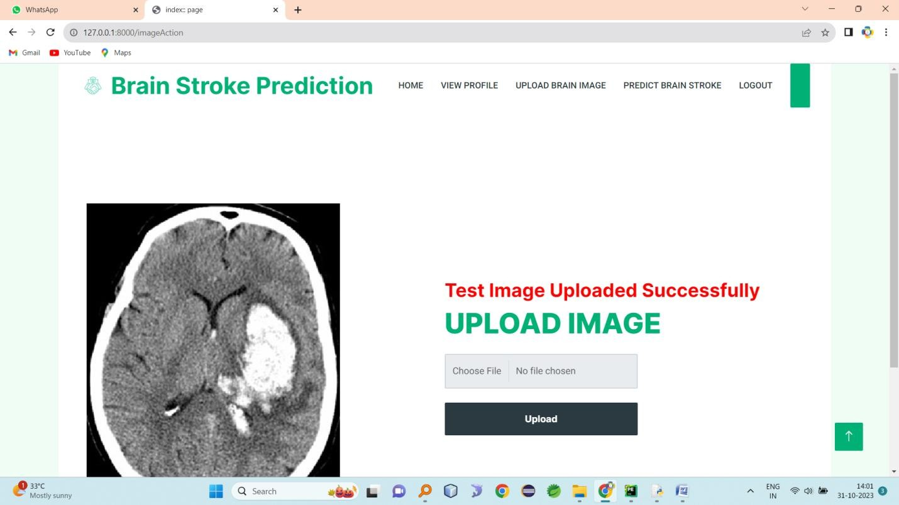
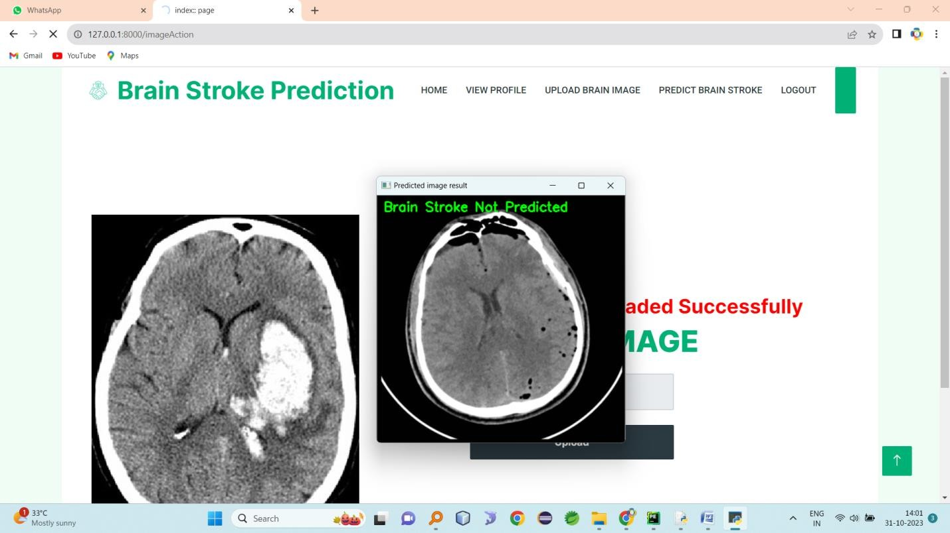

Slide 25
THANK YOU
27-Apr-23
Dept of MCA
<number>
Notes:
25

